Slide 1
The Use of Natural Language Processing in Detecting Trends of Cyberbullying in Social Media among Filipino Adolescents
Samantha Mallari
Faith Ballesteros
Eva Samillano

Slide 2
Background of the Problem
How did bullying change over a period of time?
-Its first discovery on primates
-During the era of the Homo-sapiens
-Bullying in the 21st century
Bullying-like behaviors are part of the human nature

Slide 3
Background of the Problem
Introduction to cyberbullying
-Definition of cyberbullying
Cyberbullying in the Philippines
-Why should we be concerned?
-The difference on how we deal with cyberbullying compared to other countries

Slide 4
Statement of the Problem
How can Natural Language Processing be used to detect trends of cyberbullying in social media sites among Filipino adolescents?

Slide 5
Objective
To apply Natural Language Processing (NLP) technology to aid in the efforts of moderators by detecting cyberbullying occurrences in social media sites automatically while they remain subtle

Slide 6
Significance
Adolescents spend more time on social networking sites compared to other age groups
Drawback:
-They are still immature
-They are not likely to tell anyone that they are being bullied
Effects of cyberbullying on an individual can spread to people whom that person frequently interacts with

Slide 7
Scope and Limitations
The project will focus on detecting and analyzing cyberbullying events which will most likely revolve around issues considered sensitive nationwide
The system will analyze posts that are available to the public
The posts must be exchanged between adolescents (people aged 10-19 years old)
The moderator is the only actor expected to directly interact with the system

Slide 8
Scope and Limitations
The provided solution will be limited to the detection of cyberbullying trends in two human languages (Tagalog and English) only
The machine’s “understanding” will be based on the context of how these particular social media posts are usually being constructed by adolescent Filipino netizens

Slide 9
Review of Related Literature
In Japan, Niita, Masui, Ptaszynski, Kimura, Rzekpka, and Araki conducted a research entitled Detecting Cyberbullying Entries on Informal School Websites Based on Category Relevance Maximization. The researchers proposed three methods in conducting their system: phase extraction, categorization and harmful word detection together with harmfulness polarity determination and relevance maximization.
Chen, Zhu, Zhou, and Xu conducted a research on Detecting Offensive Language in Social Media to Protect Adolescent Online Safety. In their study, the team proposed the Lexical Syntactical Feature (LSF) approach to identify offensive contents in social media and to predict a user’s potentiality to send out offensive contents.

Slide 10
Review of Related Literature
In 2012, Dinakar, Jones, Havasi, Lieberman, and Picard conducted a research on Common Sense Reasoning for Detection, Prevention and Mitigation of Cyberbullying. Removing of stop-words and tokenizing the text to separate words from punctuation marks were performed.
In 2015, Van Hee et al, conducted a research on Automatic Detection and Prevention of Cyberbullying. The team developed an annotation scheme for the analysis of textual cyberbullying.

Slide 11
Technical Background
DATA COLLECTION
We constructed a corpus by collecting data from different social networking sites such as Facebook (groups), Twitter and Ask.fm
Through web scraping, we were able to obtain preliminary data for our dataset. The web scraping tool that we used for obtaining our data was Import.io
We were able to collect more than 3000 posts (made by Filipinos) in their respective social networking accounts

Slide 12
Technical Background
DATA ANNOTATION
There are two levels of annotation
First, annotators will define whether a post contains cyberbullying content or not by indicating the harmfulness of the message.
When the message is considered harmful and contains indications of cyberbullying, annotators should indicate the role of the author of the post.
At the second step, text spans with relevant information to the type cyberbullying will be identified and categorized.

Slide 13
Technical Background
For each statement, annotators define whether the post contains indications of cyberbullying and how severe these indications are by assigning a harmfulness score based on a three point scale (0, 1, and 2)
The annotators will also identify the role of the participants in a cyberbullying scenario (harasser, victim, bystander-defender, and bystander-assistant)
At the second level of annotation, data will be classified into one of the five categories: Threat, Insult, Defense, Sexual talk, and Curse
All annotations were performed using the BRAT annotation tool

Slide 14
Event Table
Event | Trigger | Source | Use Case | Response | Destination
The moderator wants to run the system | The moderator presses ‘Run’ | Moderator | Moderator enables plug in | System starts operating | Moderator
The moderator wants to check reports regarding posts which contains indications of cyberbullying | The system encounters text or posts in social media | Post | The moderator receives graphical reports | System converts data in graphical reports and stores it in its own database | Moderator
The moderator wants to validate the system by adding new words in the database |  | Moderator | Moderator validates the system | The system’s database is updated | System

Slide 15
UML Diagrams

Slide 16
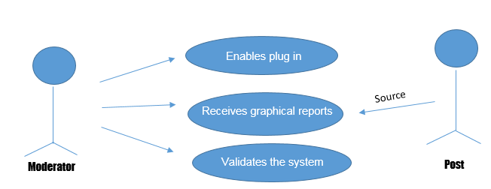
Use Case Diagram

Slide 17
Use Case Diagram
NUMBER | 1
USE CASE NAME | Moderator enables plug in
SCENARIO | The moderator wants to run the system
TRIGGERING EVENT | The moderator wants to ensure the safety in social media accounts
BRIEF DESCRIPTION | As soon as the moderator enables the plug in, the system begins to run.
RELATED USE CASE | None
STAKEHOLDERS | None
ACTOR(S) | Moderator
BASIC FLOW | ACTOR ACTION | SYSTEM RESPONSE
 | Step 1: Moderator clicks ‘Run’ | Step 2: System starts operating
PRECONDITION | User must install the plug in
POSTCONDITION | User successfully started the system

Slide 18
Use Case Diagram
NUMBER | 2
USE CASE NAME | Receives graphical reports
SCENARIO | The moderator wants to check reports regarding posts which contains indications of cyberbullying
TRIGGERING EVENT | The moderator wants to monitor the activities in social media accounts
BRIEF DESCRIPTION | The system begins to analyze posts and classifies whether it is cyberbullying related or not. As soon as the system detects that the post contains indications of cyberbullying, it records the information gathered to its own database and converts it into graphical reports.
RELATED USE CASE | None
STAKEHOLDERS | None
ACTOR(S) | Moderator
BASIC FLOW | ACTOR ACTION | SYSTEM RESPONSE
 | Step 6: The moderator receives and views the graphical reports | Step 1: System analyze posts whether it is cyberbullying related or not Step 2: If the system detects that the post was cyberbullying related, then it classifies whether the poster is a bully, bullied, or a bystander. Step 3: The system records the information gathered Step 4: The system updates its database Step 5: The system converts the obtained information to a graphical representation
PRECONDITION | System analyze posts and classifies whether it is cyberbullying related or not before storing it in its own database
POSTCONDITION | The moderator receives and views the graphical reports

Slide 19
Use Case Diagram
NUMBER | 3
USE CASE NAME | Moderator validates the system
SCENARIO | The moderator updates the database of the system
TRIGGERING EVENT | The moderator wants to validate the system by adding new harmful phrases to the database
BRIEF DESCRIPTION | The moderator will update the database by adding new words in the database
RELATED USE CASE | None
STAKEHOLDEFRS | None
ACTOR(S) | Moderator
BASIC FLOW | ACTOR ACTION | SYSTEM RESPONSE
 | Step 1: Moderator updates the data store which stores the words pertaining to possible cyberbullying occurrences
PRECONDITION | User must install the plug in
POSTCONDITION | User successfully updated the data store of the system

Slide 20
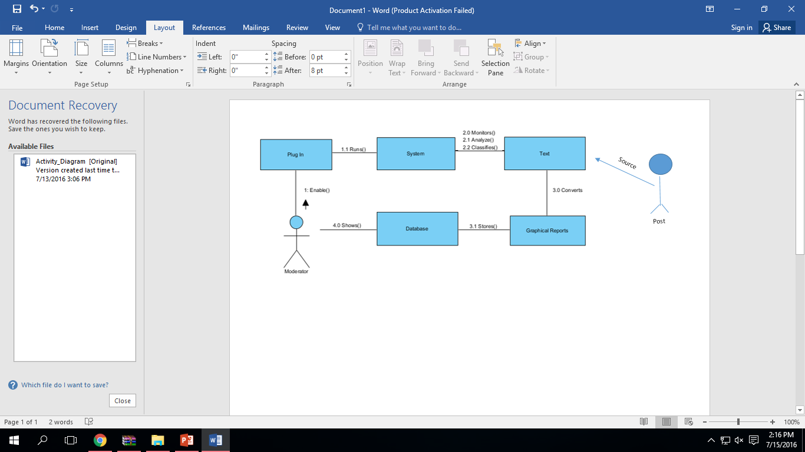
Communication Diagram

Slide 21
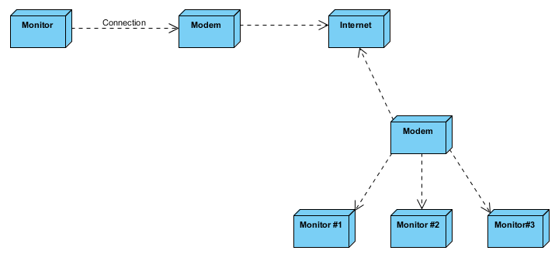
Deployment Diagram

Slide 22
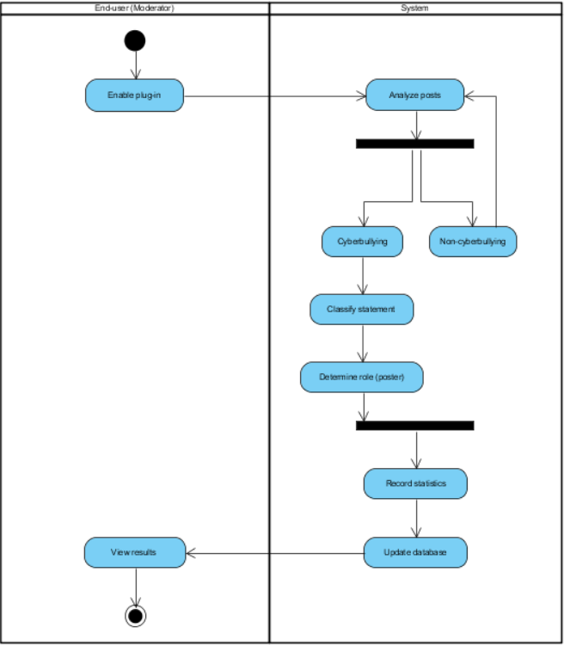
Activity Diagram

Slide 23
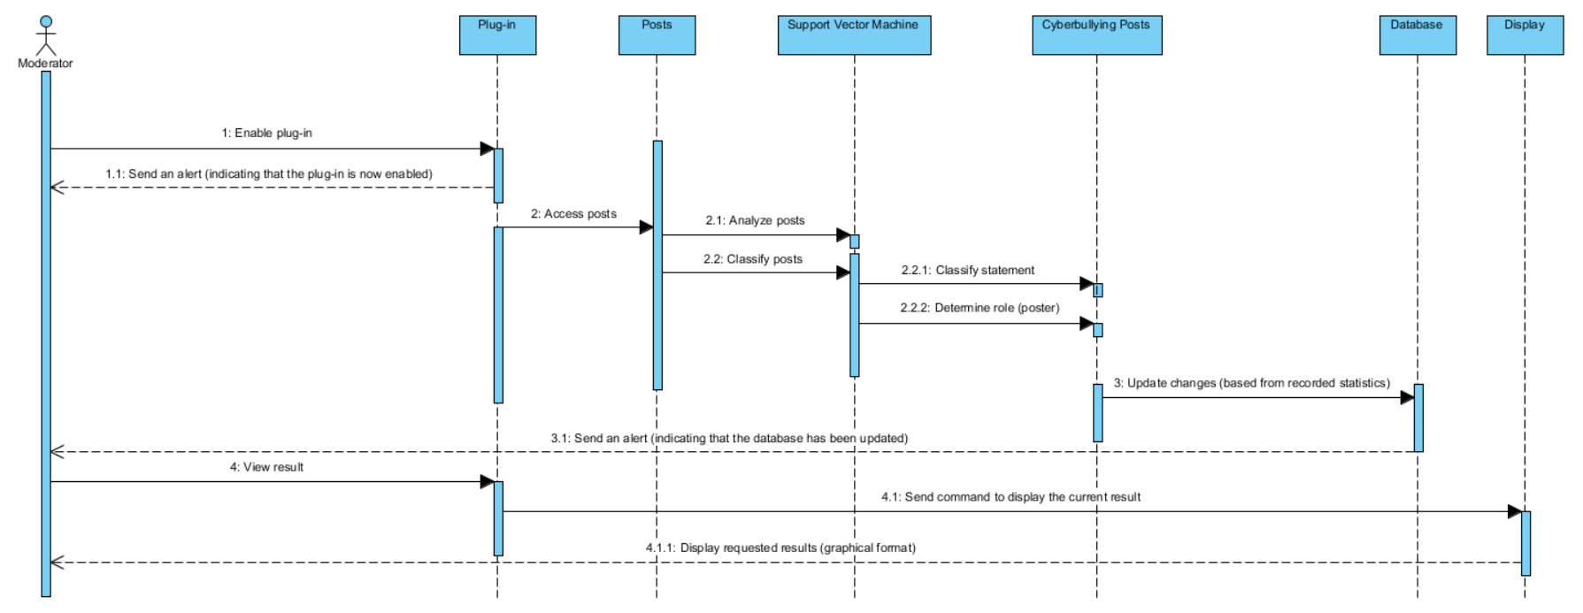
Sequence Diagram

Slide 24
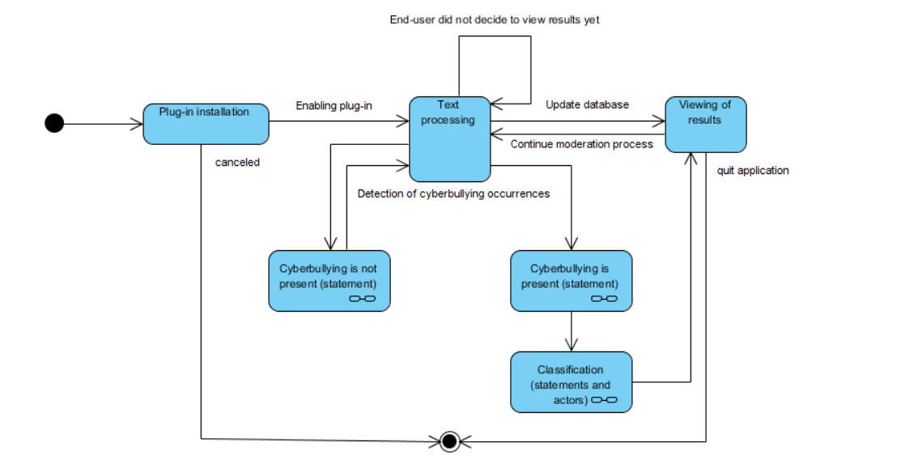
State Machine Diagram

Slide 25
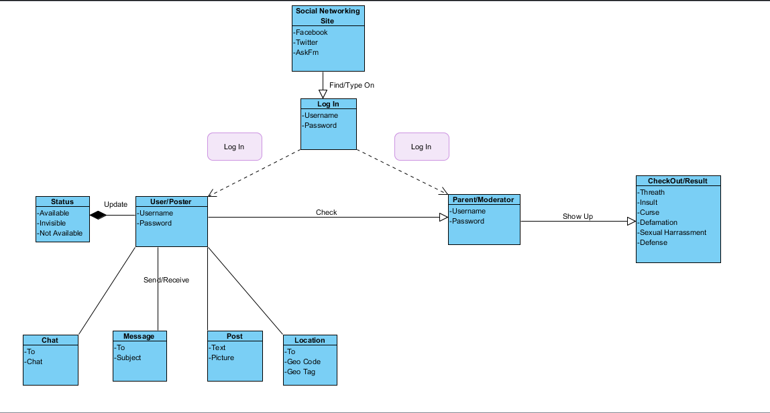
Class Diagram
M
1
1
1
1
1
1
1
1
1
1
1
1
M
M
M
M

Slide 26
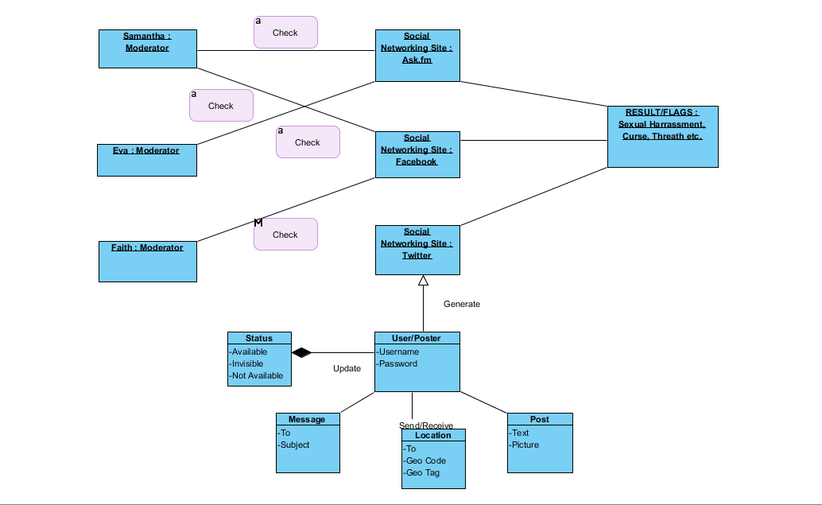
Object Diagram

Slide 27
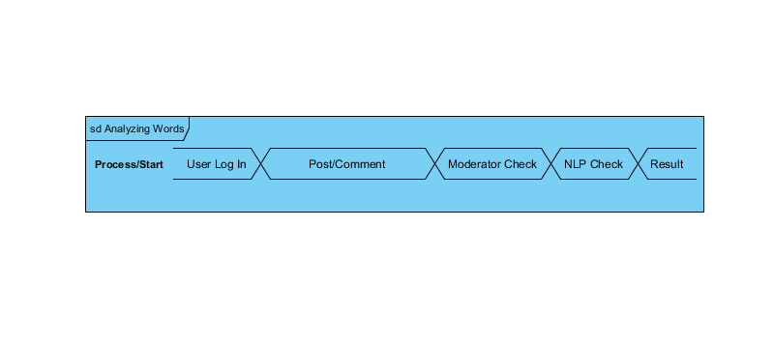
Timing Diagram

Slide 28
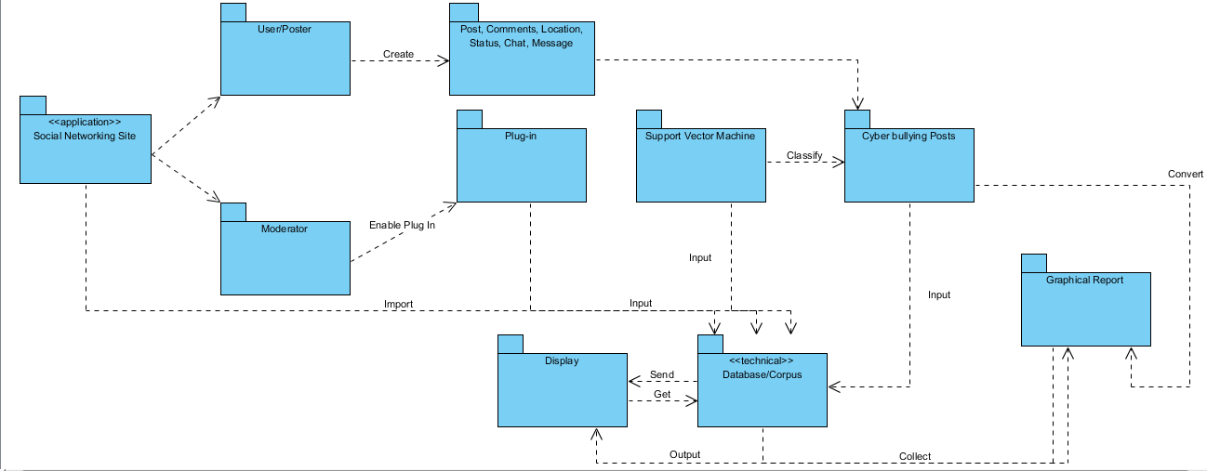
Package Diagram

Slide 29
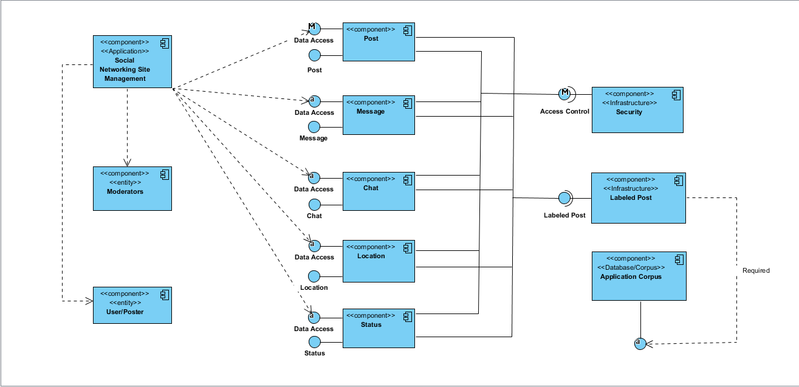
Component Diagram

Slide 30
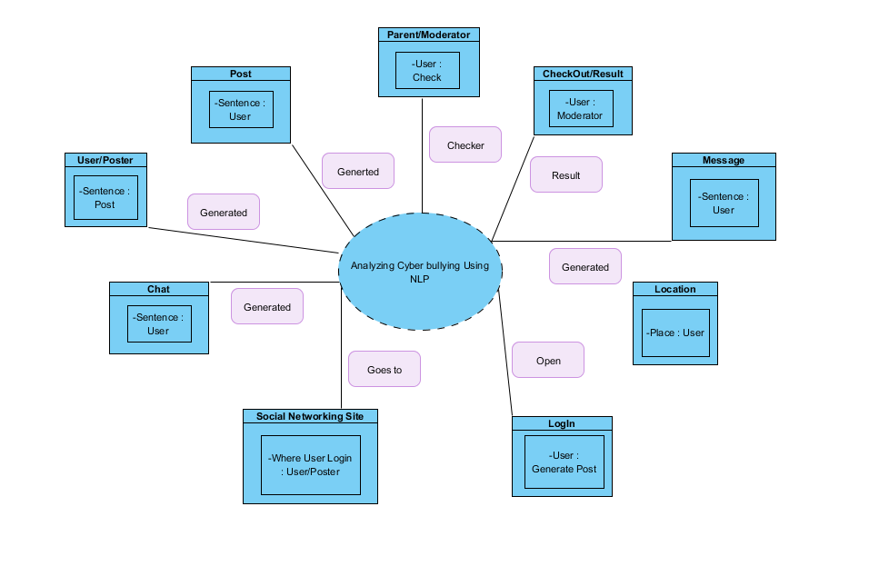
Composite Structure Diagram

Slide 31
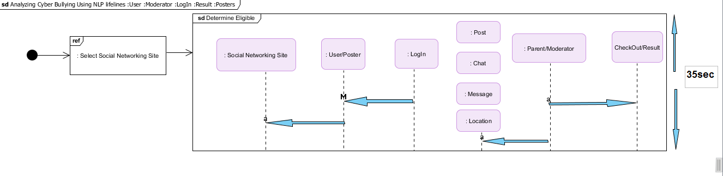
Interaction Diagram

Slide 32
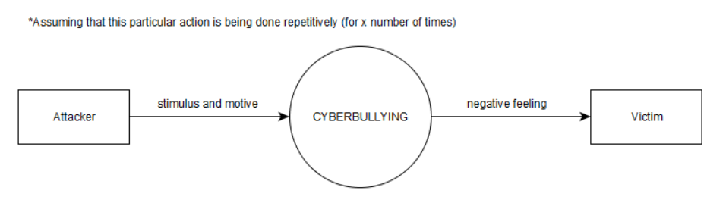
Context Diagram

Slide 33
Dataflow Diagrams (DFD)

Slide 34
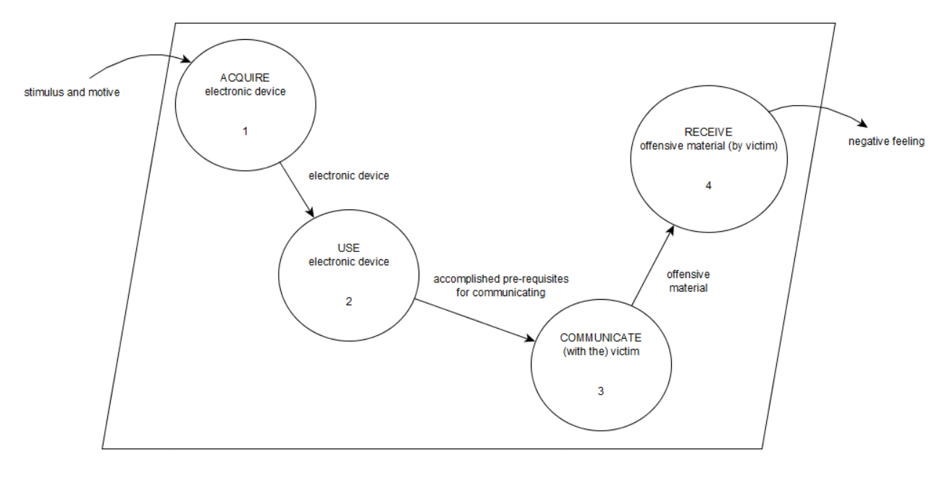
Diagram 0

Slide 35
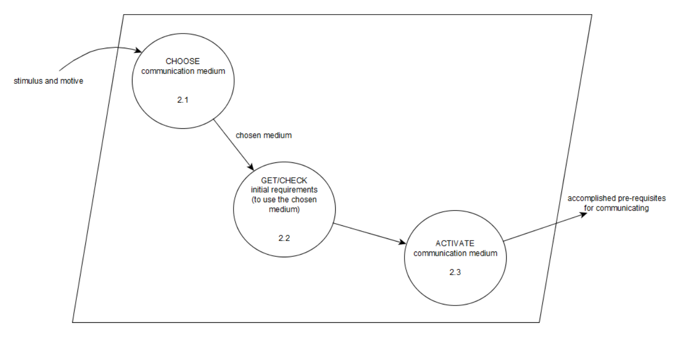
Diagram 1

Slide 36
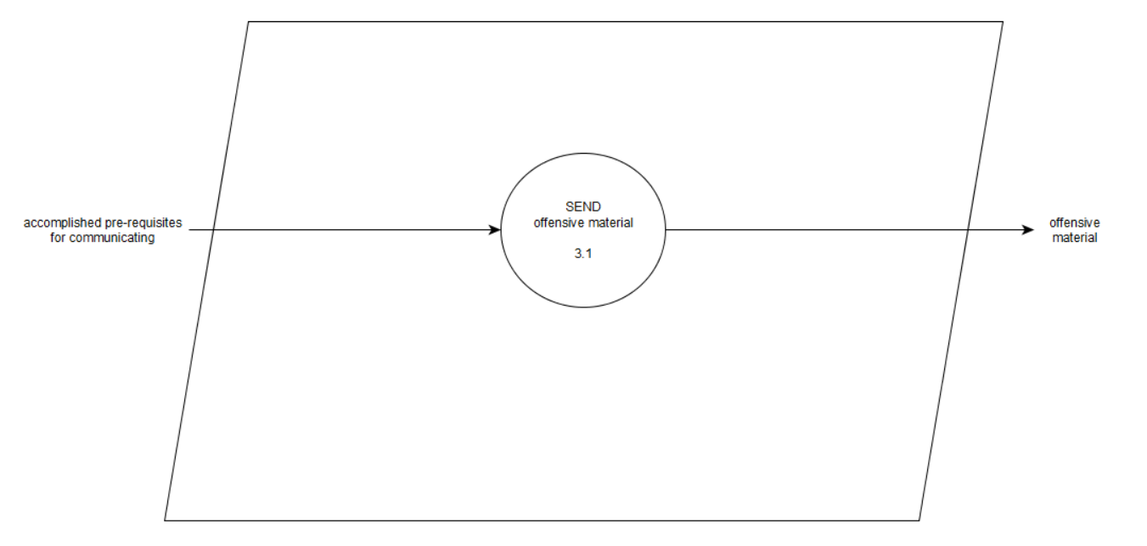
Diagram 2

Slide 37
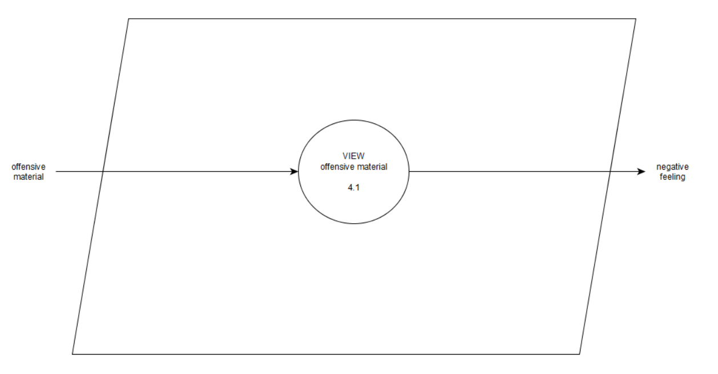
Diagram 3

Slide 38
Data Dictionary
Diagram 0
Process 1
electronic device = [smart phone | tablet | desktop computer | laptop | gaming console | smartwatch | iPod | smart TV]
Diagram 2
Process 2.1
communication medium = [e-mail | sms | chat | forum/newsgroup | social media sites | blog | call | video call | instant messaging | voice messaging]
Process 2.2
initial requirements = [internet connection | cellphone load | Bluetooth | mobile data | call cards]

Slide 39
Data Dictionary
Diagram 3
Process 3.1
offensive material = [text | image | video | voice message]
Diagram 4
Process 4.1
offensive material = [text | image | video | voice message]

Slide 40
Process Specifications
Diagram 0
Process 1
The attacker, by any means (e.g. buy a new one, borrow from a friend, etc.), gets his/her preferred device (assuming that he/she owns one or more of the types of electronic devices defined).
Diagram 2
Process 2.1
The bully will select a communication medium (where he/she could execute his/her attack). Typically, this particular medium is the most accessible one to use (for him/her), or this is where the attacker had established a solid group of friends who will be there to act as his/her support (despite the wrongdoing that is going to be committed) to ensure the latter's protection.

Slide 41
Process Specifications
Process 2.2
Once he/she (the attacker) has chosen his/her preferred medium, the next step is to make sure that he/she has enabled or acquired the materials needed in order to make the communication (through the medium) possible. This is what this specific process is all about. He/she can look for a Wi-fi hotspot if they are planning to use a communication service on the web, or they can load some balances into their cell phones to express themselves through text. The possibilities will depend on what communication medium he/she has picked.
Process 2.3
In this process, the bully is expected to log-in to an account (or sign-in to create one) that he/she will use to harm the victim (in the event that the attacker has chosen web communication services as his/her medium for sending the offensive material). Opening their sms app from their smartphones can also be included here. Anything that has to do with 'logging himself/herself inside' the medium that was chosen falls under this process

Slide 42
Process Specifications
Diagram 3
Process 3.1
Process 3.1 focuses on the act of reaching-out to the victim by means of sending offensive materials to his/her respective account, inbox (for phones and e-mail), etc. The term 'sending' in this process include posting, commenting, 'tweeting', etc. the offensive material since such things were made visible on that particular website because the bully "sent" them through the network.

Slide 43
Process Specifications
Diagram 4
Process 4.1
This final process determines whether the material sent is indeed offensive or not to the victim. There are cases where a particular message will either leave a negative impact on a person or not. It depends on their corresponding views with regard to the thing that was sent to them. This stage is crucial for the development of the project because the only way to find out if the 'flagged' words are indeed cyberbullying trends is by asking that same person as well if it had offended him/her in some way. However, whether or not the user finds a particular word (that was 'flagged'), the system will still need to keep its watch on the pertained words (due to the fact that it might be considered harmful on a different person).

